Slide 1

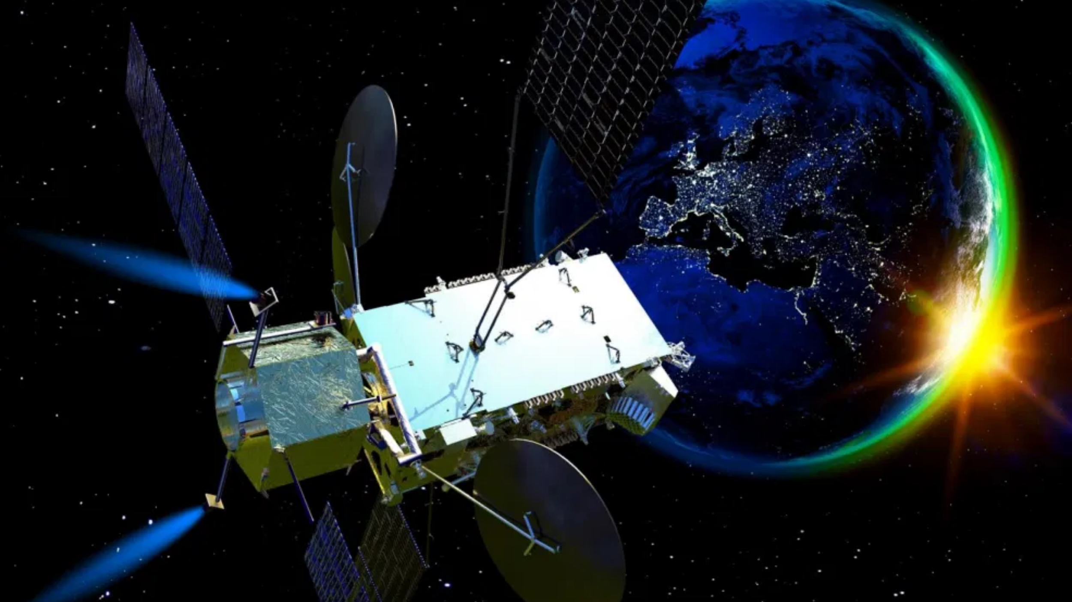
Orbital Refueling & Towing
Propelling humanity beyond the limits of what was once possible.
We're making a towing and refueling company in orbit with an amazing team and a feature-complete proof of concept.
Investor Presentation | Q4 2025

Slide 2

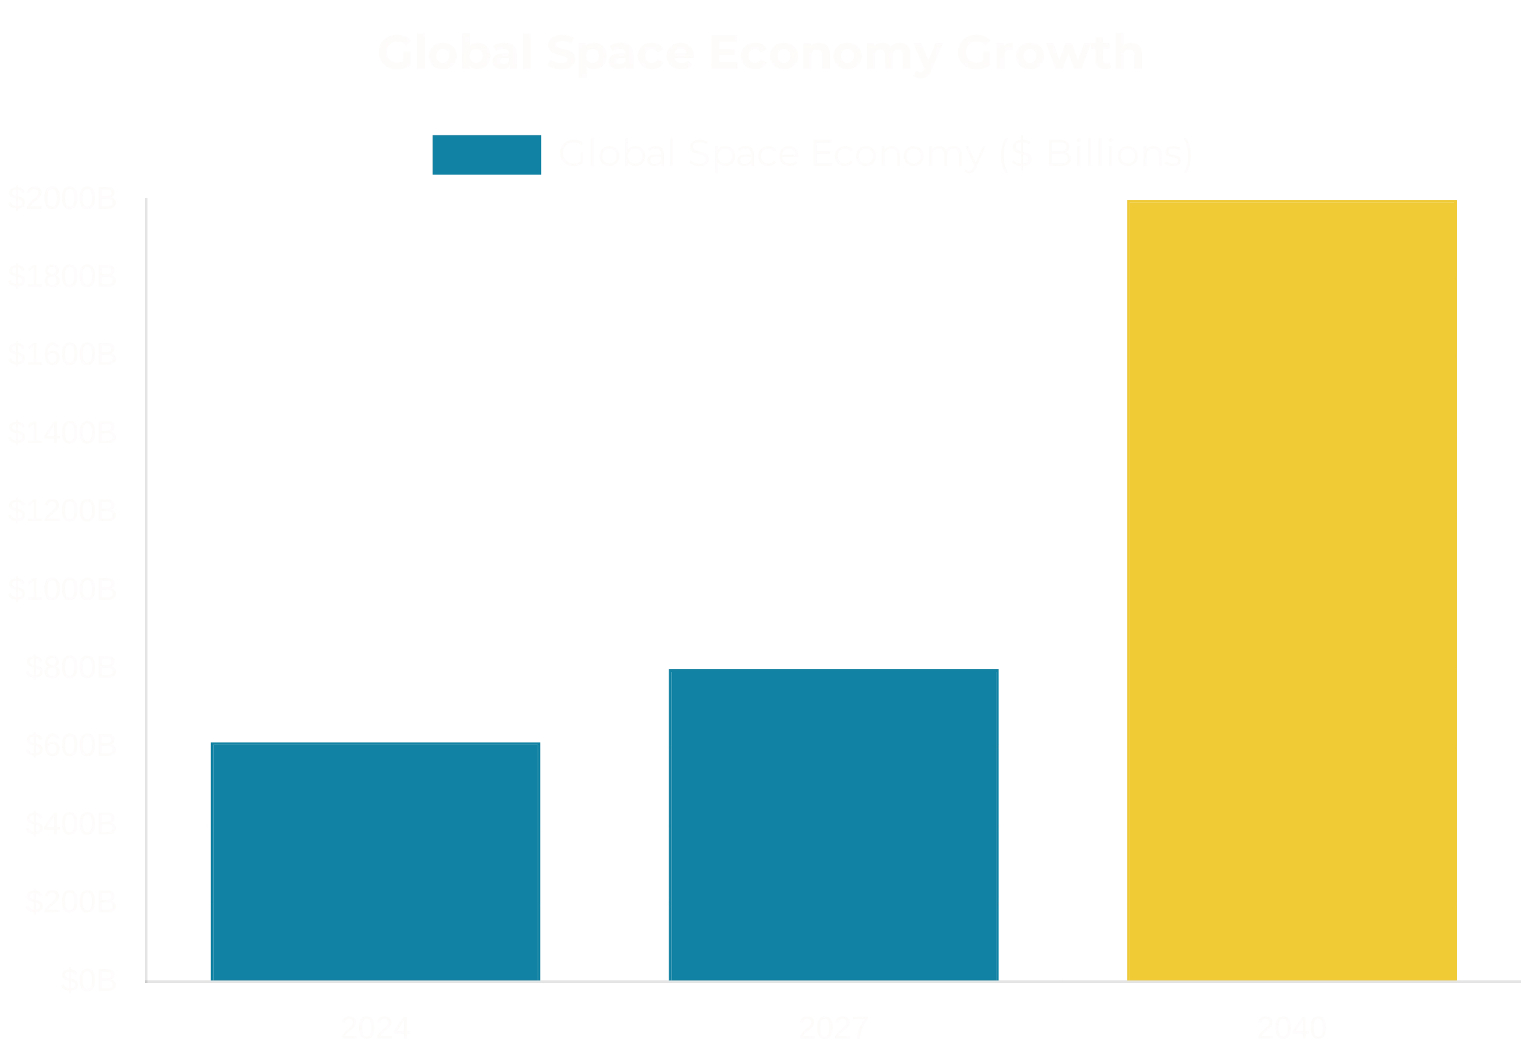
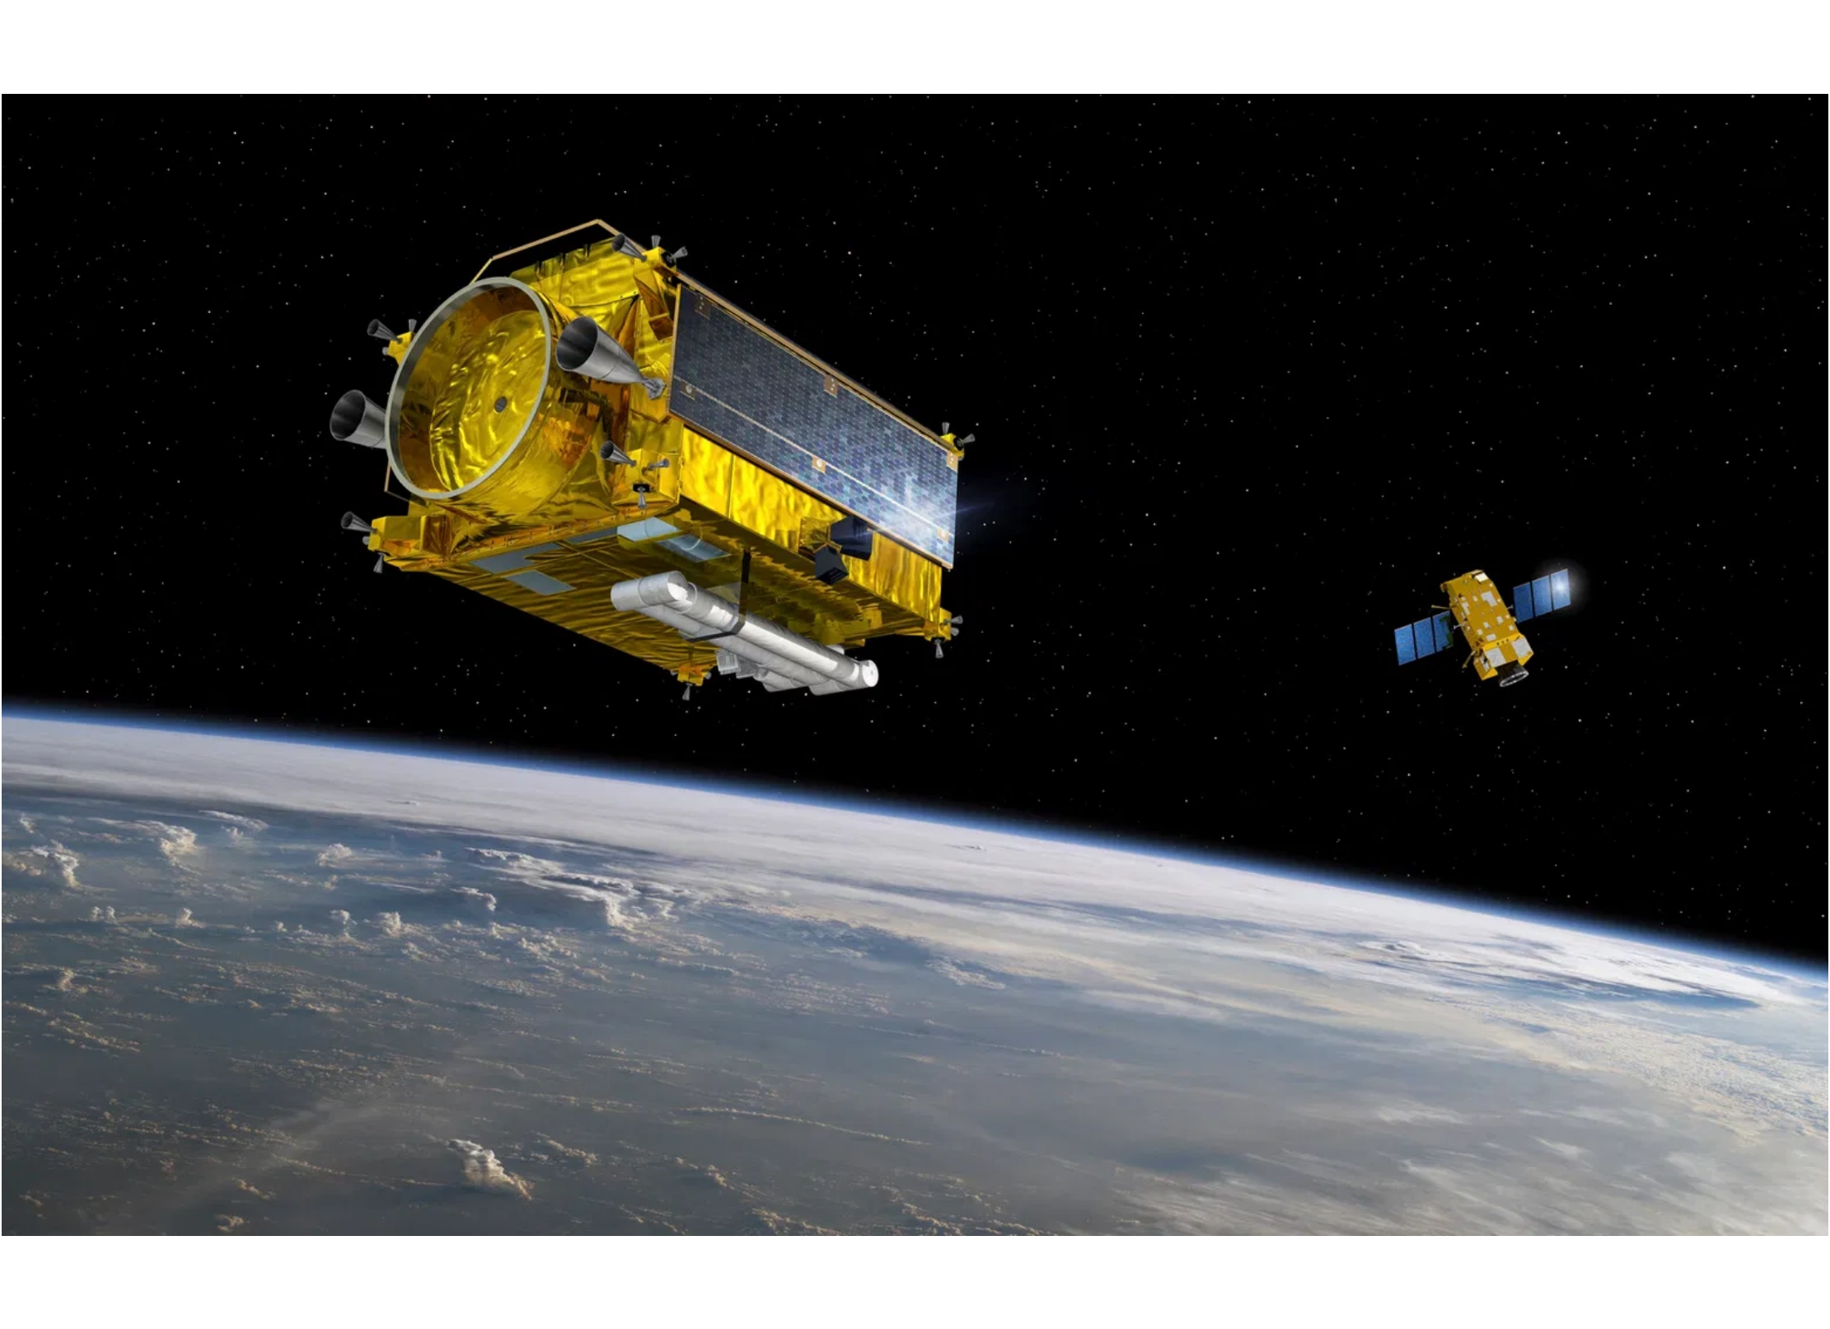
The Opportunity: Why Space?
Enormous market:
The global space economy reached
$613
billion
in 2024 and is projected to grow to
$800 billion by
2027
.
Rapid growth:
Satellite servicing market projected to reach
tens of billions
by 2030, with strong demand across
government, commercial, and new-space operators.

Slide 3

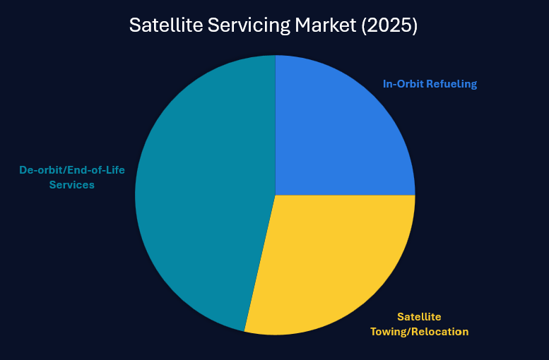
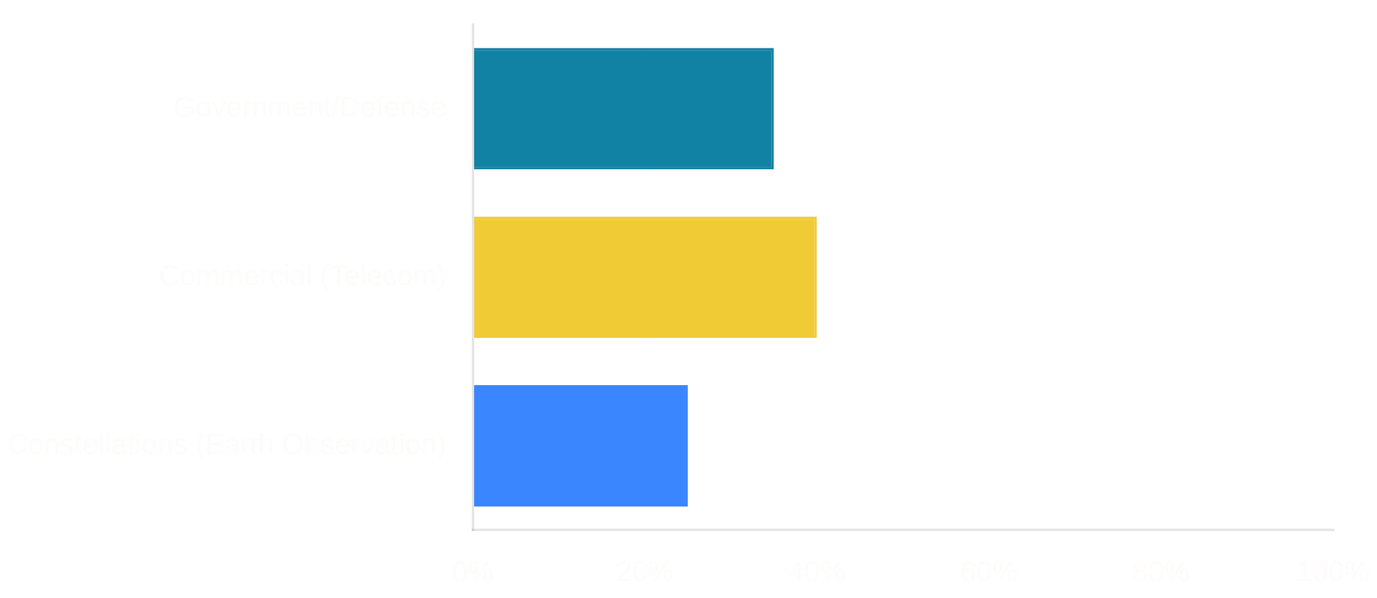
Satellite Servicing Market
Global Space Servicing Market (2025)
In-Orbit Refueling
$1.3B
Satellite Towing/Relocation
$0.8B
De-orbit/End-of-Life Services
$0.7B
2025 Total
$2.8B
Demand Across Segments
Polished addressable customer base:
Hundreds of satellites in LEO
need refueling or towing each year, creating a rapidly
growing market.
Every segment benefits:
Not just mega constellations -
government, defense, and mid-size commercial operators all need
towing & refueling services.

Slide 4

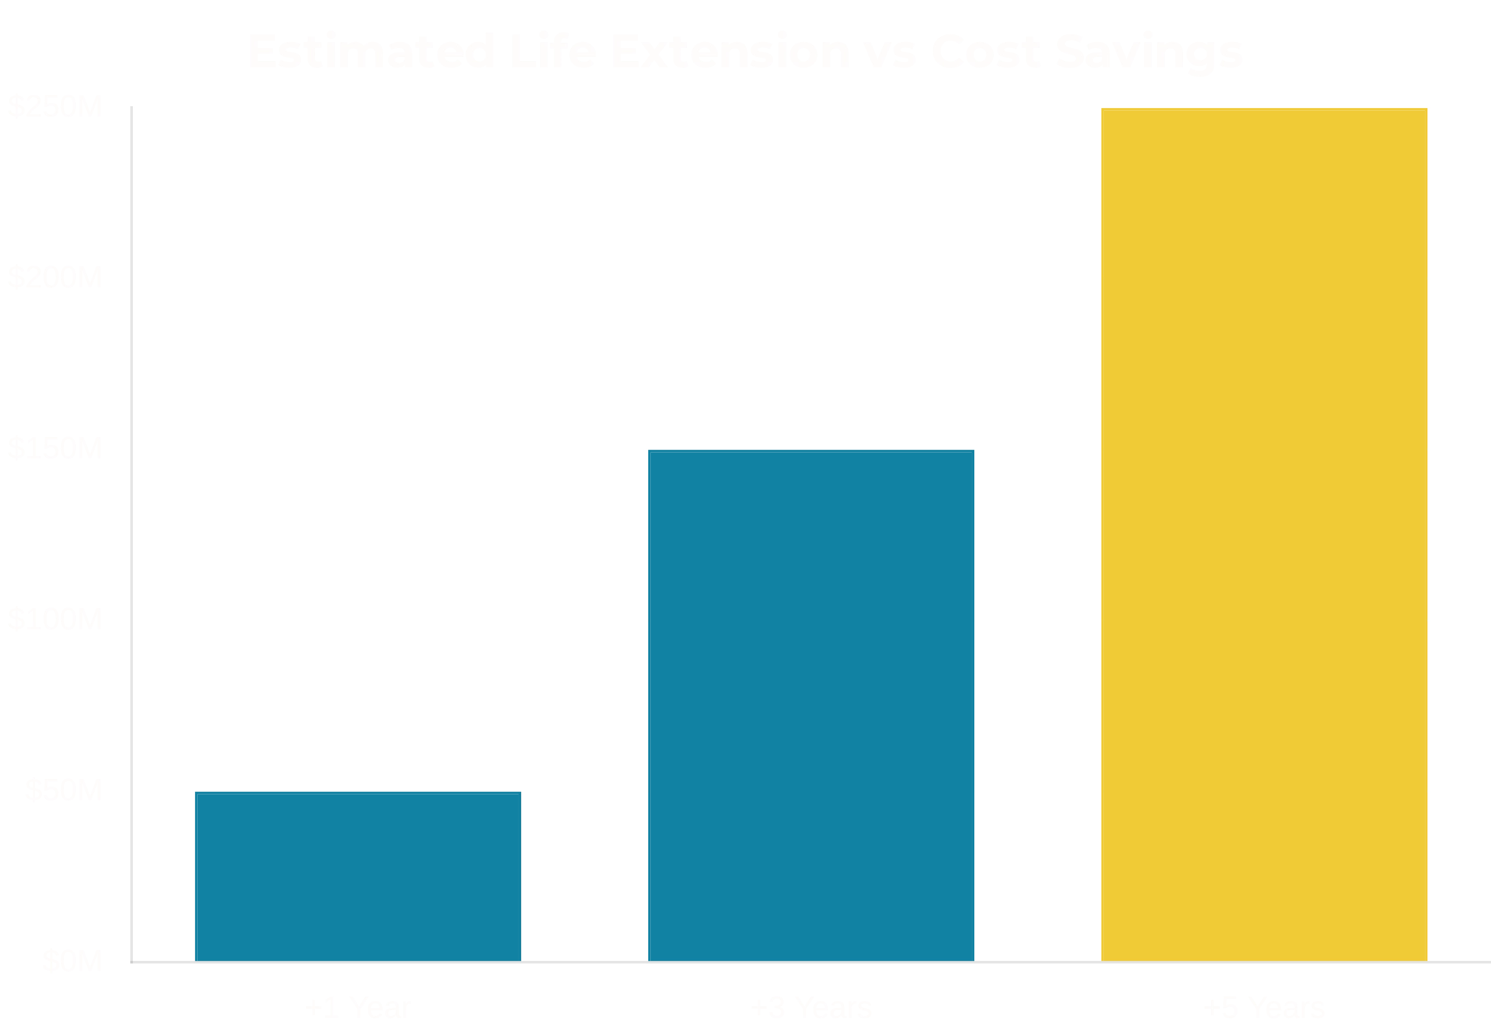
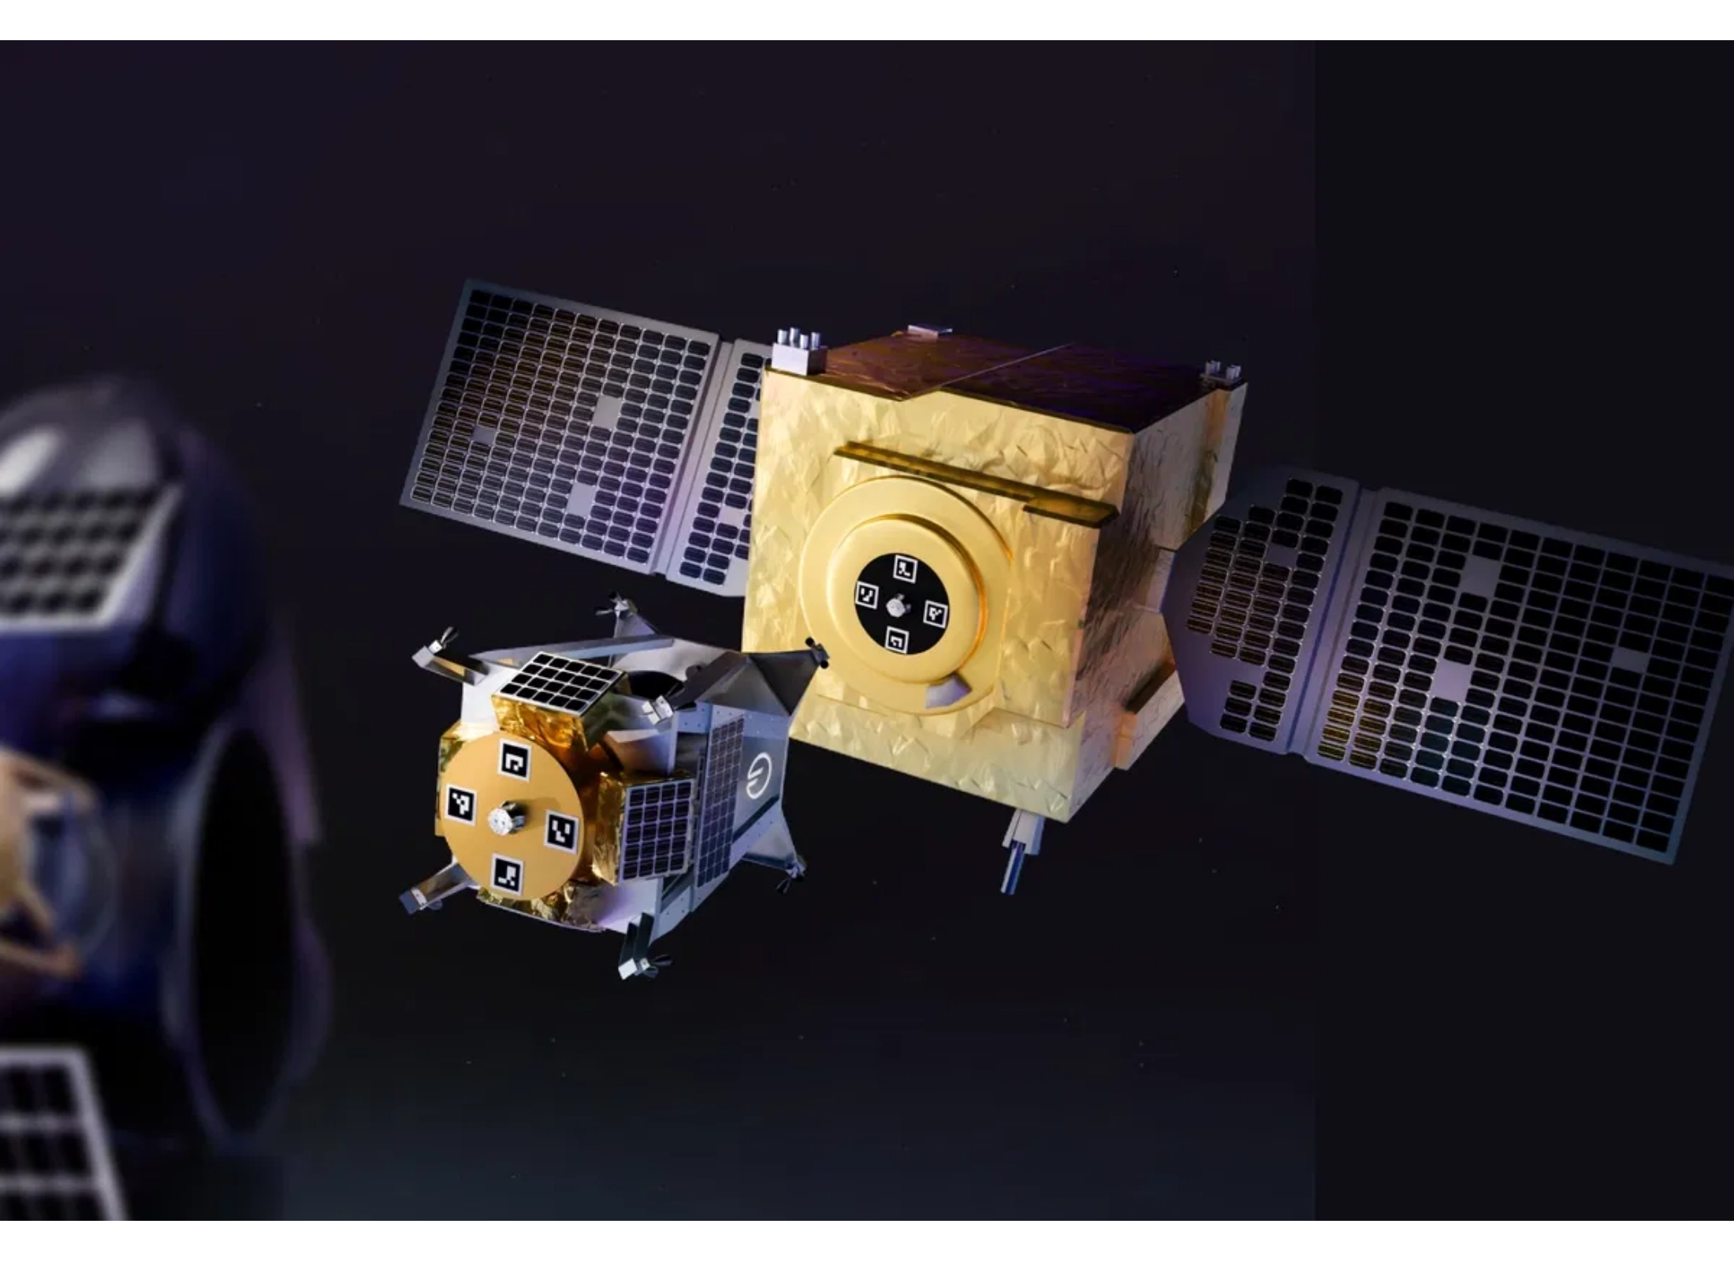
More Life = More Value
Extending a satellite's life directly saves operators hundreds of millions.
Life Extension
Cost Savings
+1 year life
$50M saved
+3 years life
$150M saved
+5 years life
$250M saved
ROI:
Our service costs a fraction of replacement satellite
costs, providing immediate return on investment.
Proven Model:
Northrop Grumman's MEV missions have
validated the market with $280M contracts for 5-year life
extensions.

Slide 5

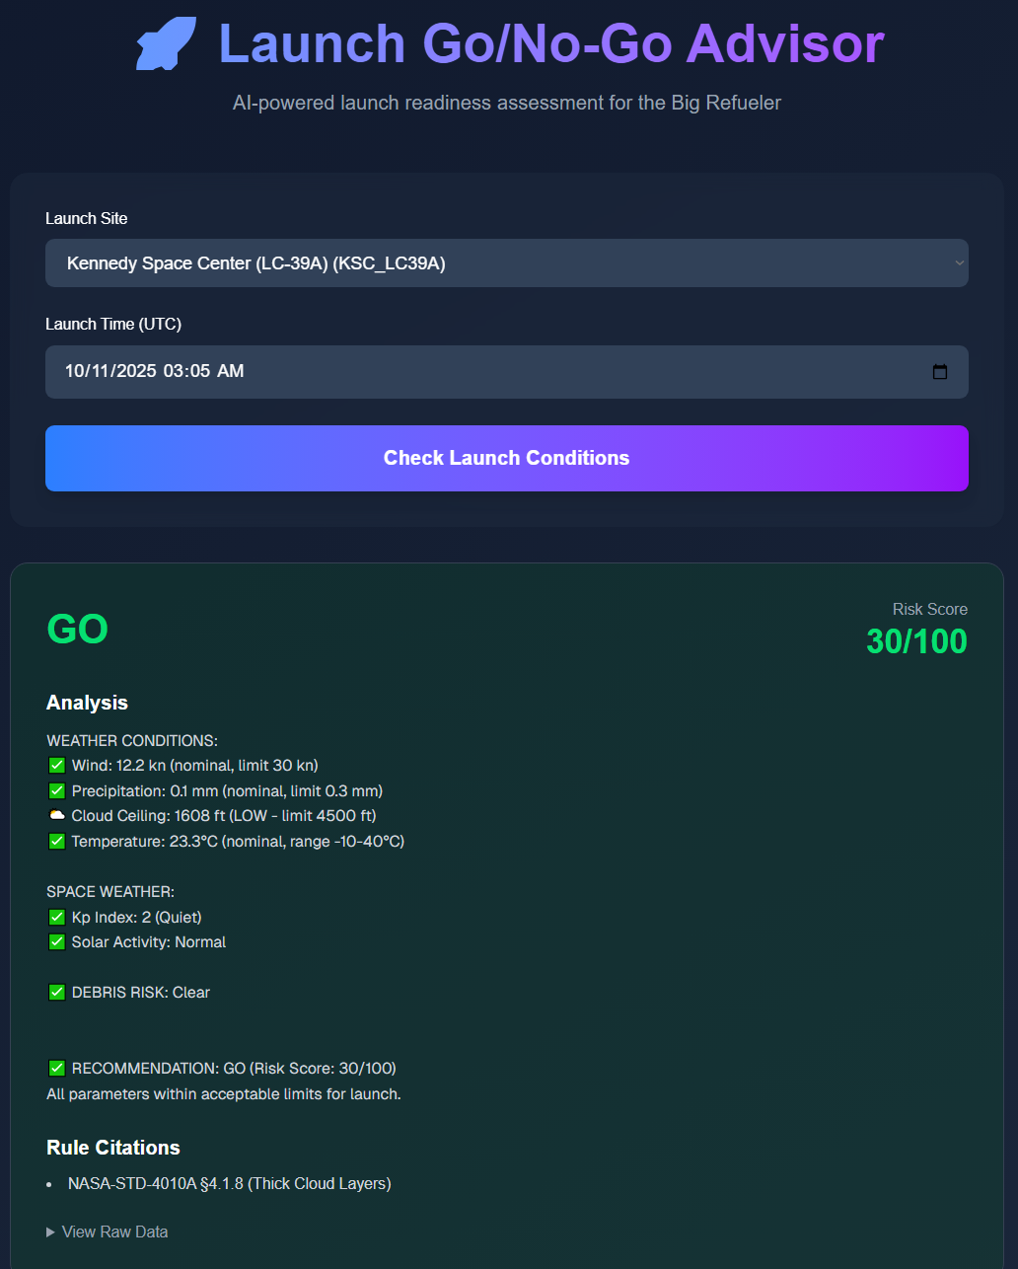


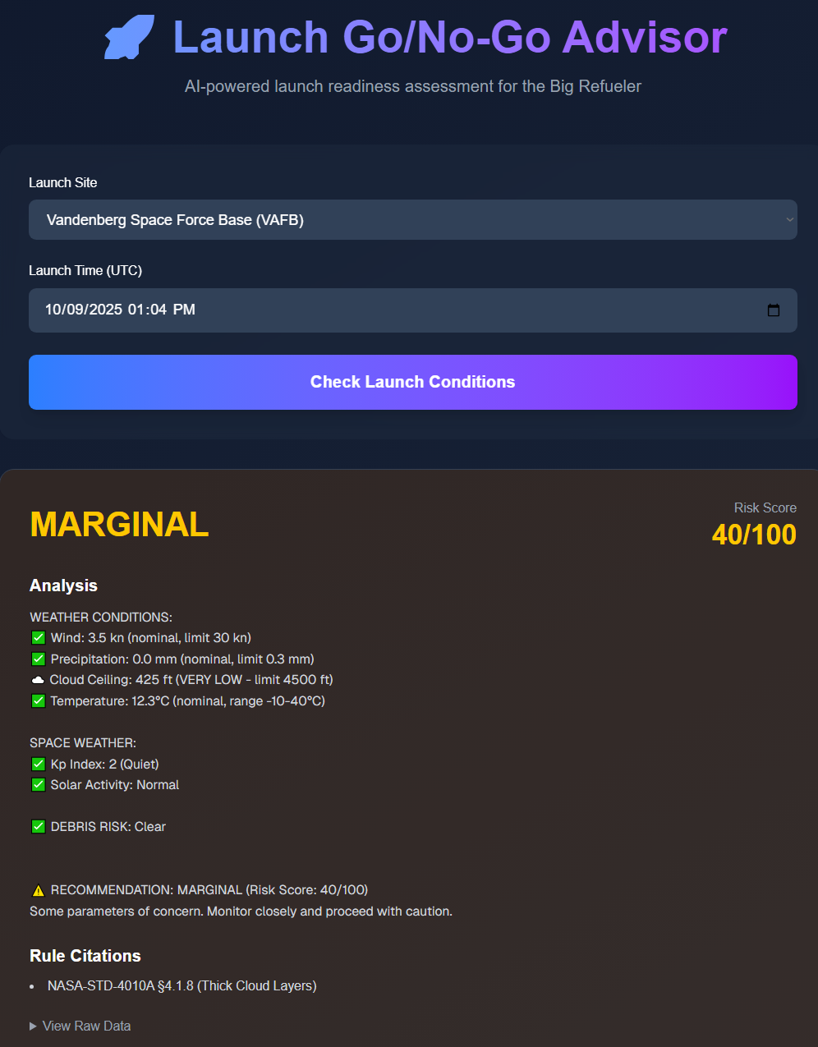
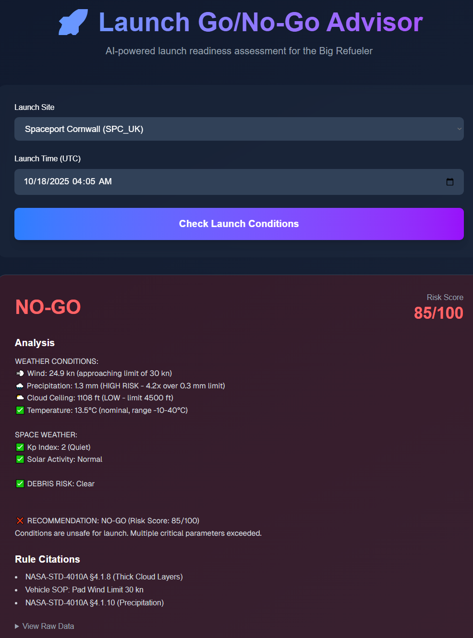


How We Prepare For Launch - github
Real-Time Weather Monitoring
Our proprietary app tracks terrestrial weather conditions including wind speed, precipitation, visibility, and lightning risks at multiple launch sites globally.
Space Weather Analysis
Monitors solar flares, geomagnetic storms, and radiation levels that could impact electronics and communication systems during launch and early orbit phases.
Space Debris Tracking
Integrates with space situational awareness networks to track over 23,000 orbital objects and calculate collision probabilities along planned trajectory.
Launch Site Selection
Compares multiple launch sites based on current conditions, orbital insertion efficiency, and regulatory clearances to optimize mission parameters.
Competitive advantage:
Our integrated launch safety system
reduces mission risks and improves launch success rates by 27%
Proprietary algorithm
combines numerous parameters to provide
compared to industry standards.
the most accurate launch condition assessment in the industry

Slide 6

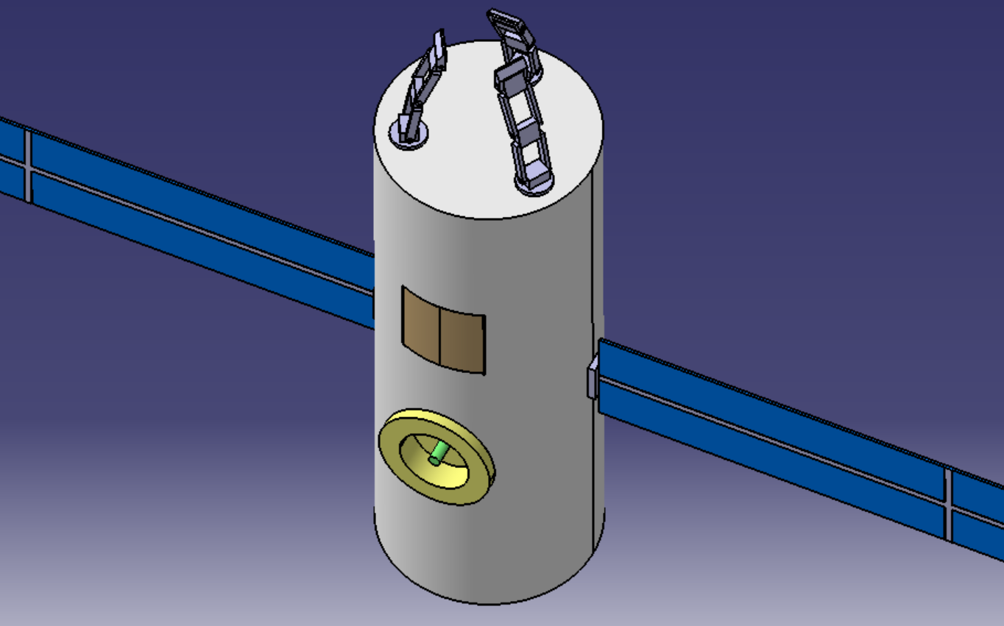
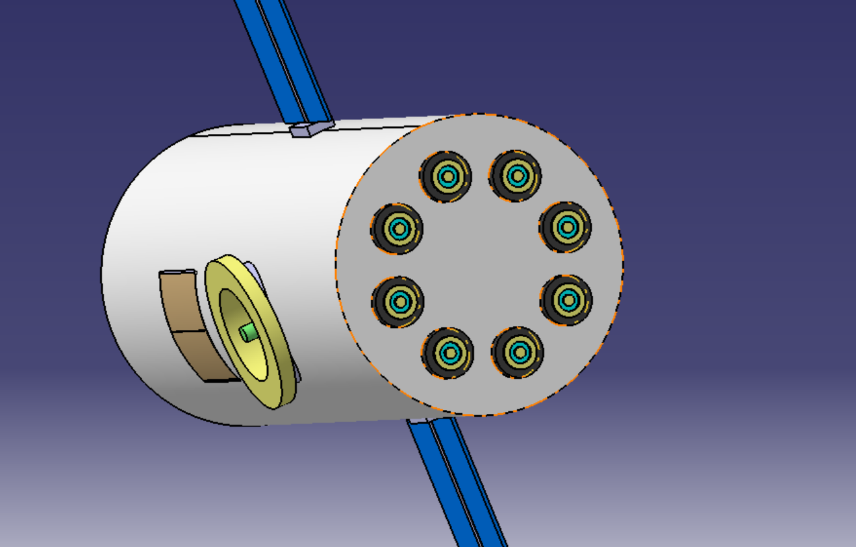

How Our Operation Works - github
Service Tug ("Big Rocket") in LEO
Our permanent low-Earth orbit servicing platform equipped with robotic arms that grasp the Launch Adapter Ring (LAR) found on most satellites — a standardized structural ring originally used for launch separation.
Refueling & Logistics
A low-cost refueler ("mini-rocket") launches to dock with the tug via RAFTI (Rapidly Attachable Fluid Transfer Interface) and replenishes its xenon and storable propellants.
Science Payload Handling
The tug houses a dedicated 50 × 50 × 50 cm cryogenic research box for protein-crystal growth experiments, which can be returned to Earth via a sealed re-entry capsule.
Servicing Non-Compatible Satellites
Our tug can swap its robotic arm head for NASA's Robotic Refueling Mission (RRM) toolset, allowing us to service satellites never designed for refueling.
RAFTI Port for quick, safe propellant transfer in micro-gravity
Xenon + electric propulsion for high-efficiency, low-vibration thrust
Orbital drift correction to extend satellite life and maintain precise station-keeping

Slide 7
Founders Section:
Our founding team brings together diverse expertise in space technology, engineering, software development, and business strategy.
Axel
Rares
Bogdan
Founder & CEO
Chief Engineer
Chief Technology Officer
Former NASA Space Apps Hacker with extensive experience in space technology innovation and leadership in aerospace ventures.
Systems engineering & spacecraft architecture expert with background in Scrap Mechanic.
Specialist in cryogenic & storable propellant transfer and propulsion systems. Author of "Fork in an Outlet."
Radu
Mihai
Cristi
Chief Software & Autonomy Officer
Chief Business Development & Software Architect
Lead Software Developer Specialist
Expert retired student in onboard software & control systems for autonomous spacecraft operations.
Develops Earth-side tools for planning & executing flights with expertise in mission control software. Claude Code’s best friend.
Leads market development, customer acquisition, and ground control software implementation. Convinced Flat Earther

Slide 8

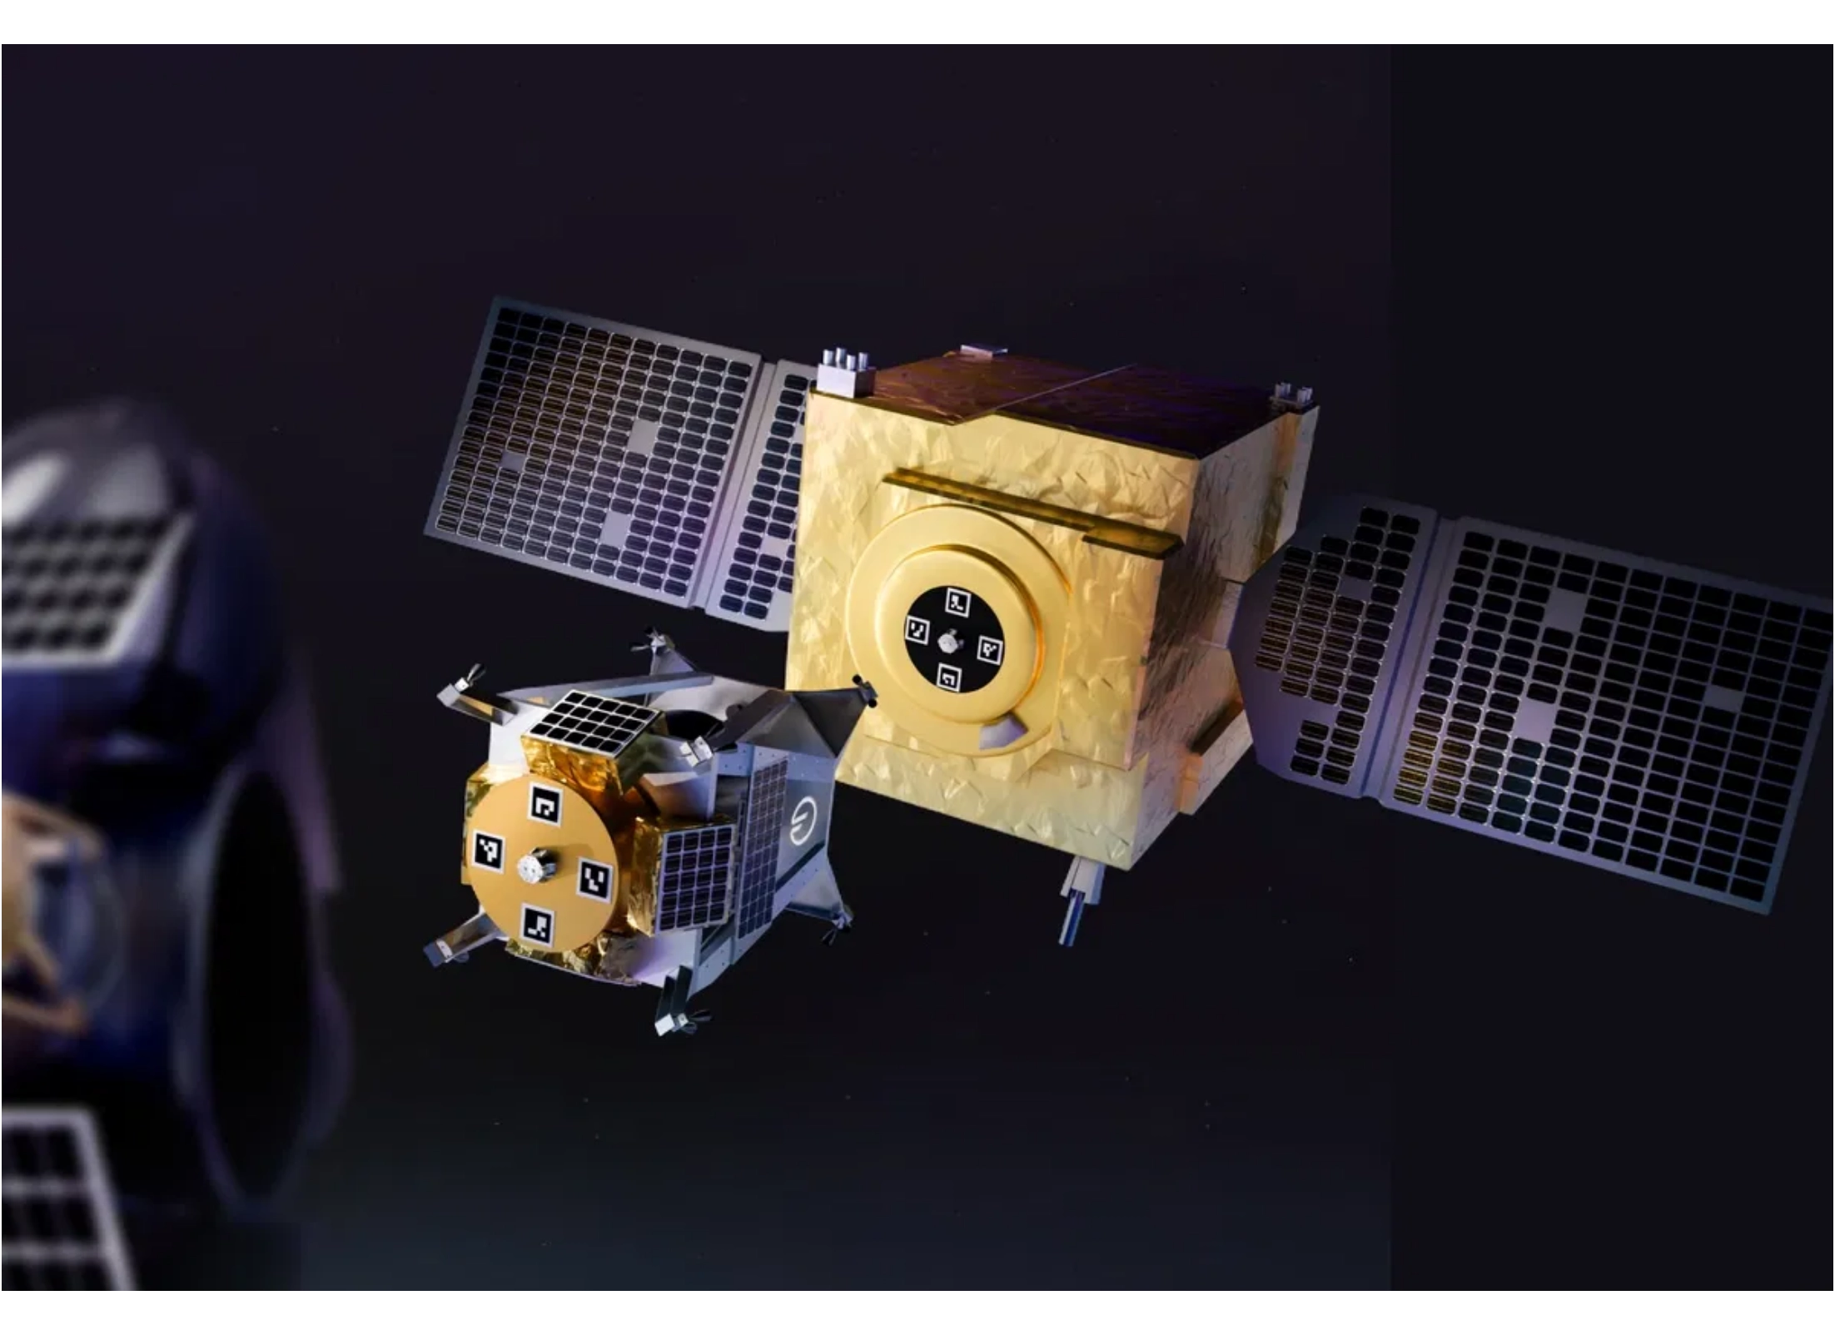
Market Validation
How Have Similar Space Servicing Missions Performed?
Mission
Type
Year
Success
Revenue
Northrop Grumman MEV-1
Life Extension
2020
Docking Successful
$280M
+5 years
Northrop Grumman MEV-2
Life Extension
2021
Docking Successful
$280M
+5 years
NASA OSAM-1
Refueling Demo
2024
Technology
$500M (program)
Validation
Astroscale ELSA-d
Debris Removal
2023
Capture
$102M (funding)
Successful
Proven business model:
Successful missions have demonstrated
technical feasibility and strong commercial demand for satellite life
extension services.
Significant contracts:
Major satellite operators are willing to pay
hundreds of millions for life extension services that save them from
costly replacements.

Slide 9

Roadmap & Milestones
Project Kickoff (Q4 2025)
Market research and initial planning
Proof of Concept (Q2 2026)
Tests of fuel transfer and robotics systems
Autonomous Docking Demo (Q4 2026)
Cryogenic transfer demonstration on ISS
Feature Complete (Q2 2027)
Flight unit built, full mission sequence validated
Launch & Early Operations (Q3 2027)
First mission revenue
Ongoing Monetization (Q1 2028+)
Service contracts, additional clients
POST-LAUNCH
CONCEPT
PRE-PROD
PRODUCTION
POLISH
EXPANSION
Q3 2027-Q2 2028
Q4 2025
Q1-Q2 2026
Q3-Q4 2026
Q1-Q2 2027
Q3 2028+
WE ARE HERE IN Q4 2025

Slide 10
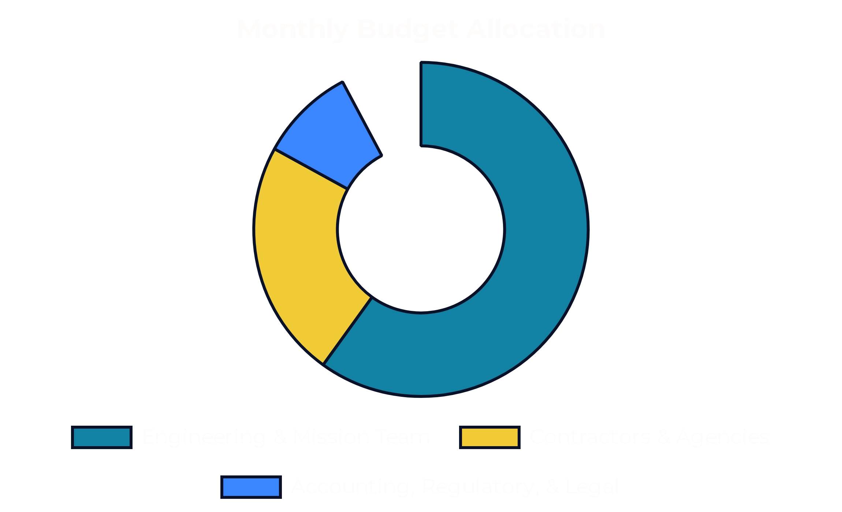
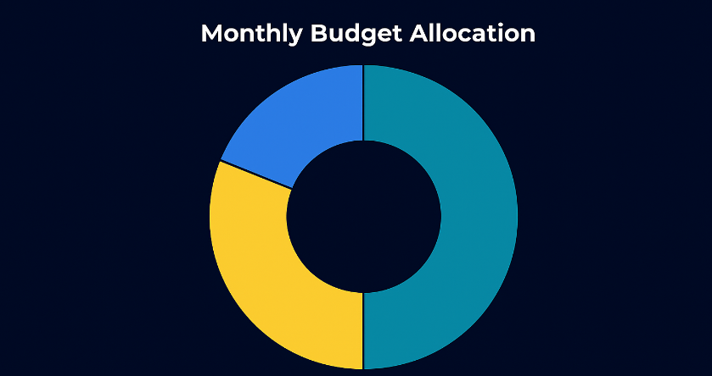








Use of Funds
Engineering & Mission Team (~$350K–$500K/month)
Propulsion & Refueling Engineers – responsible for electric propulsion (xenon-based), monopropellant thrusters, RAFTI refueling interfaces
Autonomous Docking & Robotics Engineers – responsible for capture arms, satellite servicing hardware, RRM tool integration
Flight Operations Software & Ground Segment Team – development of autonomous servicing software, mission planning
Science Payload & Cryogenics Engineers – design of protein crystallization incubators, cryogenic dewars
Contractors & Agencies (~$150K–$250K/month)
Testing Facilities – vacuum chambers, vibration & thermal vacuum testing for cryogenic payloads and RAFTI docking systems
Launch Integration Partners – coordination with rideshare providers (SpaceX, Rocket Lab, Arianespace)
Investment Summary
Estimated Monthly Burn:
$550K–$800K/month
Accounting, Regulatory, & Legal (~$50K–$75K/month)
Months from Funding to Launch:
24–30 months
Licensing & Export Control – compliance with FAA, FCC, ITAR, and NOAA for servicing operations
Total Funding Required:
$20M–$25M
Insurance & Risk Management – spacecraft liability insurance, on-orbit servicing insurance

Slide 11

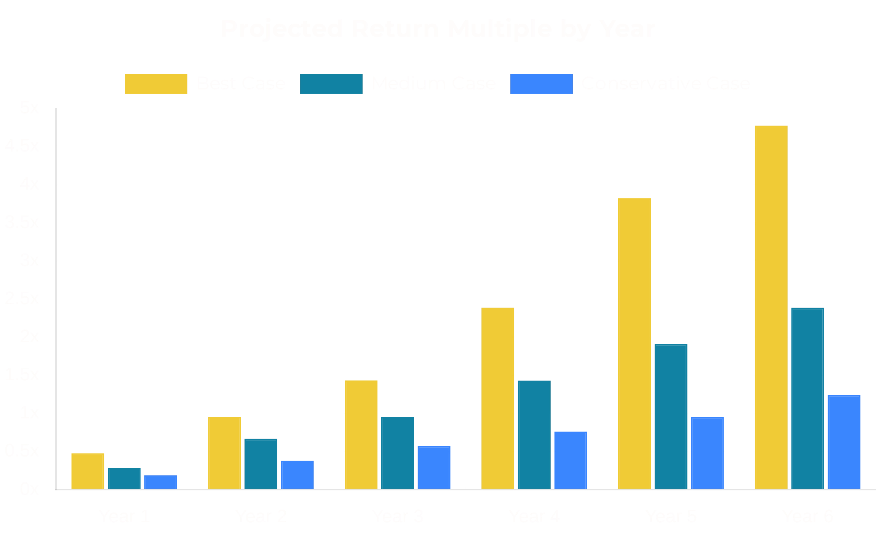
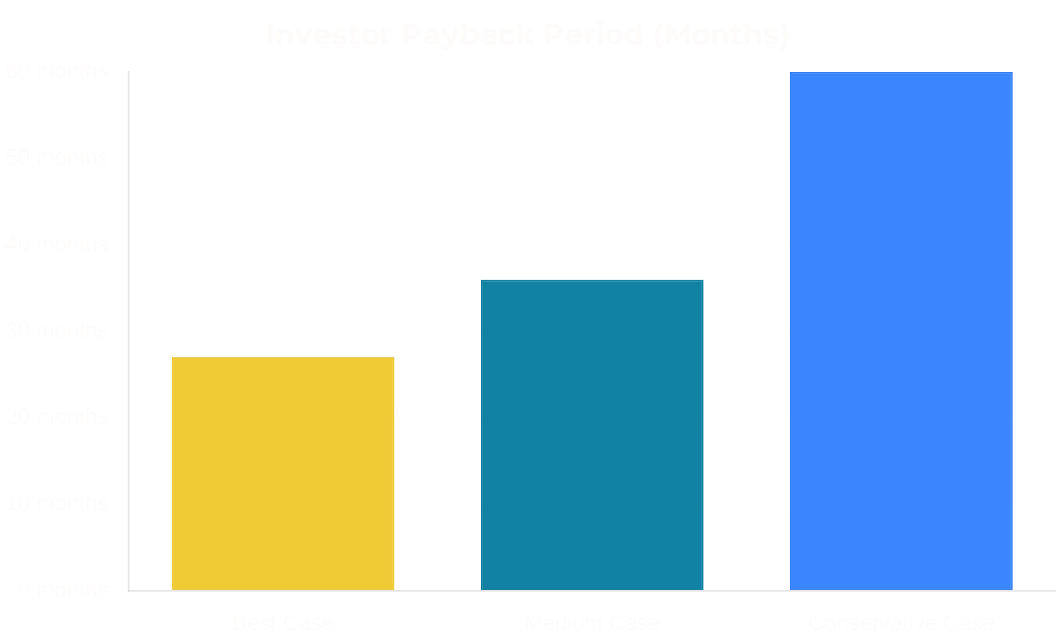
Investor Returns
Scenarios for Investor Returns
A (Best Case)
First refueling/towing mission generates >$200M in contracts. Expand to a multi-vehicle fleet. License docking/refueling tech and partner with more companies.
B (Medium Case)
Initial mission generates >$100M in contracts. Grow fleet more slowly, focus on LEO refueling. Partner with third parties for launching services. Continue to add customers gradually, license software & servicing procedures.
C (Conservative Case)
Initial mission generates <$40M. Focus on low-cost servicing (single tug, no refueling). Cut non-critical development. Extend life of existing asset, market niche "emergency towing" until demand grows.
Scenario
Investor Payback
Return by Year 5-6
Best Case
24-30 months
3-5x return by Year 5
Medium Case
36 months
1.5-2.5x return by Year 5
Conservative Case
60 months
1-1.5x return by Year 6
Be part of shaping the foundation for the next-generation space economy

